Slide 1
Support vector machine in machine learning
- sai raj

Slide 2
Support vector machine:
SVM or Support Vector Machine is a machine learning model used for classification and regression problems.
It can solve linear and non-linear problems and work
well for many practical problems.
The idea of SVM is simple: The algorithm creates a line or a hyper plane which separates the data into classes.

Slide 3
Hyper plane :
The SVM algorithm helps to find the best line or decision
boundary, this best boundary or region is called as a hyper plane.
We always create a hyper plane that has a maximum margin,
which means the maximum distance between the data points.
The hyper plane with maximum margin is called the optimal hyperplane

Slide 4
Support Vectors:
The data points or vectors that are the closest to the hyperplane.
SVM algorithm finds the closest point of the lines from both the classes.
These points are called support vectors
Margin:
The distance between the support vectors is called as margin

Slide 5
Types of svm
Svm can be of two types :
1.Linear svm(lsvm): Linear svm is used for linearly separable data,
which means if a dataset can be classified into two classes by
using a single straight line, then such data is termed as linearly
separable data, and classifier is used called as Linear SVM classifier.

Slide 6
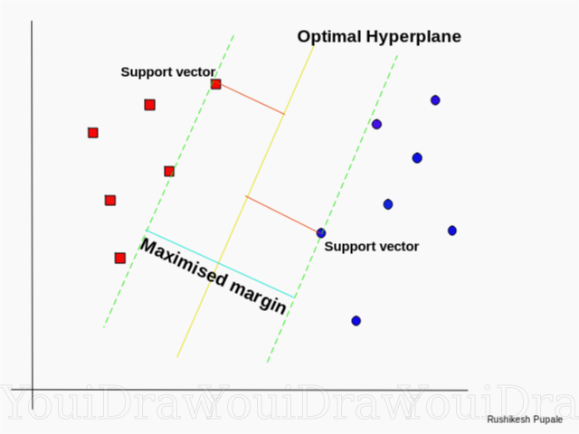

Slide 7
2. Non linear svm (nlsvm):
Non-Linear SVM is used for non-linearly separated data,which
means if a dataset cannot be classified by using a straight line,
then such data is termed as non-linear data and classifier used
is called as Non-linear SVM classifier.

Slide 8
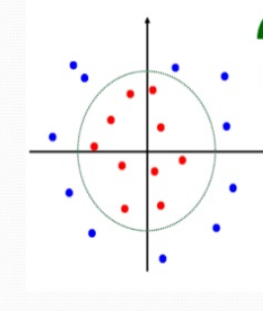

Slide 9
Kernels
In
support vector machine

Slide 10
Kernels:
A kernel transforms a low-dimensional input data space into a
higher dimensional space. So, it converts non-linear separable
problems to linear separable problems by adding more
dimensions to it.
Thus, the kernel trick helps us to build a more accurate classifier.
Hence, it is useful in non-linear separation problems.

Slide 11
Types of kernels:
In svm there are 4 kernels
Linear kernel
polynomial kernel
Radial basis function(RBF) kernel
sigmoid kernel

Slide 12
Linear kernel:
It helps to draw a best fit line that separates both the
classes linearly.
Linear kernel support vector machines have good
performance only on very simple problems.
Polynomial kernel:
We use simply calculate the dot product by increasing
the power of the kernel.

Slide 13
Radial basis function :
RBF is the most popular support vector machine kernel choice,
and the default one used in sklearn.
RBF is short for (radial basis function). It is a general-purpose kernel;
used when there is no prior knowledge about the data.
Here curve work like wave.
Sigmoid kernel:
Mostly use in deep learning , to solve ANN based problems.

Slide 14
C and gamma in svm
Since kernels transforms data into higher-dimensional spaces ,
machine learning algorithms making use of the kernel trick
have a tendency to overfit.
The sklearn SVM methods provide C and gamma functions
C & Gamma is a hypermeter which is set
before the training model and used to control error .

Slide 15
Advantages of svm classifier:
It works really well with clear margin of separation.
It is effective in high dimensional spaces.
They work well for both high and low dimensional data.
Disadvantages of svm classifier:
They have high training time so it is not suitable for large datasets
It also doesn’t perform very well , when the data set has more noise.

Slide 16
Thank you

